Slide 1
Optional Practical Training (OPT)
Notre Dame International International Student and Scholar Affairs (ISSA)
105 Main Building Walk-in Hours : Monday – Friday, 1– 4 p.m.

Slide 2
What is OPT?
OPT is one year of work authorization to allow for practical experience within the field of study.
Students are eligible if enrolled full time for one academic year.
All employment MUST be related to the degree program.
One year of OPT is available for each degree level.
If OPT is not used, it is forfeited. It cannot be reclaimed later.
You choose the dates, within certain limitations.
OPT is not employer-specific; no offer of employment is required to apply.

Slide 3
Types of OPT
PRE-COMPLETION OPT
POST-COMPLETION OPT
POST-COMPLETION OPT STEM EXTENSION
*Each type of OPT requires a separate application and approval by USCIS.

Slide 4
Important Dates for Post-Completion OPT
90 days before
Program End Date
60 days after
Program End Date
Program End Date
February 18, 2019
May 19, 2019
July 18, 2019
If USCIS receives the OPT application packet before or after this time range, it will be DENIED!
Other Important Dates
Receipt Notice Arrival: within three weeks after submitting application
EAD Card Start Date: set within 60 day grace period
Unemployment: allowed 90 days of unemployment from start date on EAD card
Notes:
Based on the Program End Date, students determine the OPT start date that will be on the EAD card.
The first possible EAD card start date is May 20, 2019; the last possible start date is July 18, 2019.

Slide 5
Process for Optional Practical Training
Student
watches the
OPT Info Video
OR
attends a OPT Info Session with ISSA advisor
Academic Advisor
receives email with link to complete OPT Advisor Recommendation e-form
Student
assembles OPT application packet and brings it to an advisor at 105 Main
Student
submits the OPT application at ISSAlink.nd.edu
Student
can begin working after receiving EAD card and reaching start date on EAD
ISSA advisor
reviews application packet and recommendation, issues new I-20 with OPT Recommendation
USCIS
sends EAD card to student, usually 90 days
USCIS
sends OPT receipt notice to students w/in three weeks
Student
mails OPT application packet to USCIS

Slide 6
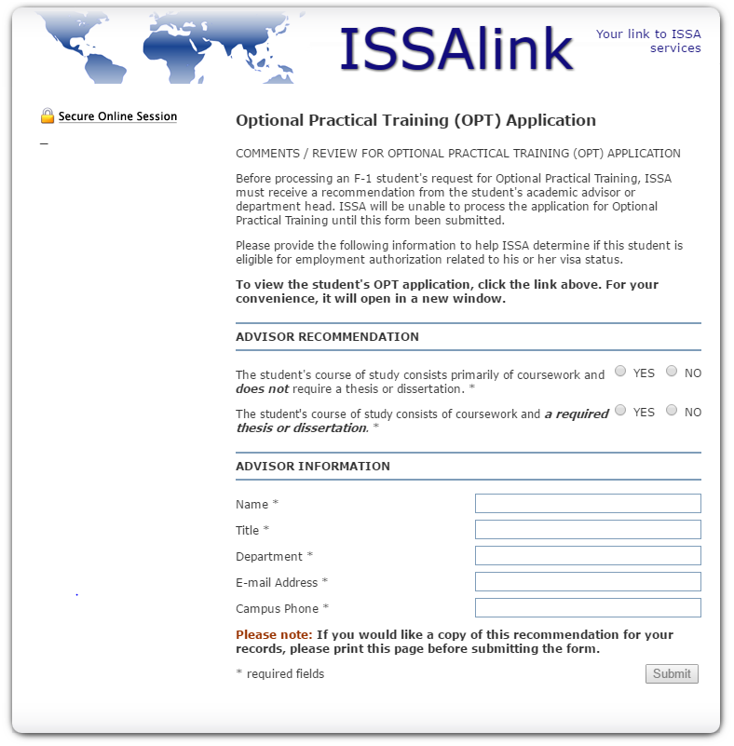
OPT e-forms at ISSAlink.nd.edu
Complete OPT Application in ISSAlink
Student
Advisor

Slide 7
Choosing a Start Date
For Undergraduates and Graduates without thesis or dissertation: Any date between the day after graduation and 60 days later.
– for May 19, 2019 graduation, July 18 is last possible start date
For Graduates with thesis or dissertation:
Any date after completion of course work, if degree will be completed before the end of the OPT.
You are not authorized to work until:
your EAD card is in hand and
the start date on the card has been reached.

Slide 8
Assemble the OPT Application Packet
The OPT Application Packet includes:
A completed and printed Form I-765
Copies of:
the biographical page of your current unexpired passport
your most-recent F-1 visa, even if it is expired
your most-recent I-94 record
any previously issued EAD cards
Two new passport-style photos; do not use photos that you have previously used for any immigration document.
A personal check, a bank check, or money order for $410 from a U.S. bank or post office, made payable to “U.S. Department of Homeland Security,” or a credit card transaction form.

Slide 9
Waiting on the EAD Card
Students cannot work or take classes:
after the program end date,
before the EAD card arrives, and
before the EAD card start date arrives.
After your program end date, activities while waiting on the EAD card are limited to recreational activities.
Volunteering in a religious institution is fine; volunteering using the skills you acquired in the program is discouraged.
If you must travel outside the U.S. after your program end date, you must have your receipt notice from USCIS.

Slide 10
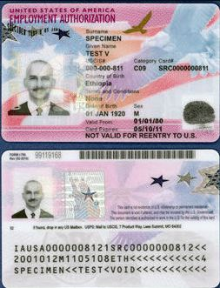
Employment Authorization Card
You cannot begin working until you have received your EAD card and reached the start date.

Slide 11
90-day Limit on Unemployment
Students may not accrue more than 90 days of aggregate unemployment during post-completion OPT.
Days of unemployment begin to accrue on the effective start date of your Employment Authorization Document if you are not employed on that date.
DHS determines whether or not a student has violated status by exceeding the limit on unemployment.

Slide 12
Maintaining F-1 Status during OPT
You are responsible to maintain your F-1 status, which means:
Maintain a valid passport
Maintain a valid I-20
Report changes within 10 days:
change of U.S. address
all employment information and changes
change in immigration status
If traveling outside the U.S.:
Travel signatures must be valid within six months of return
Valid F-1 visa is required for re-entry
Enter the U.S. in F-1 status for duration of OPT
Carry evidence of work authorization and employment
Notify ISSA if you permanently depart the U.S. before OPT ends.

Slide 13
Options after OPT
Within the 60 Day Grace Period after OPT, you may:
Travel within the U.S. until grace period finishes
Depart the US
Begin a new degree program at ND or elsewhere
Change to a new visa type

Slide 14
H-1B Cap-Gap Extensions
Students whose employers have timely filed a cap-subject H- 1B petition prior to the expiration of OPT automatically qualify for an extension of F-1 status and OPT employment authorization to September 30.
Students whose H-1B petitions are filed during the 60-day grace period after the expiration of OPT qualify for an extension of F-1 status to September 30. Employment authorization is not extended.
Cap-gap extensions are granted automatically.
A student may request a new I-20 indicating that a cap-gap extension has been granted by providing ISSA with a copy of the H-1B receipt or approval notice, as required.

Slide 15
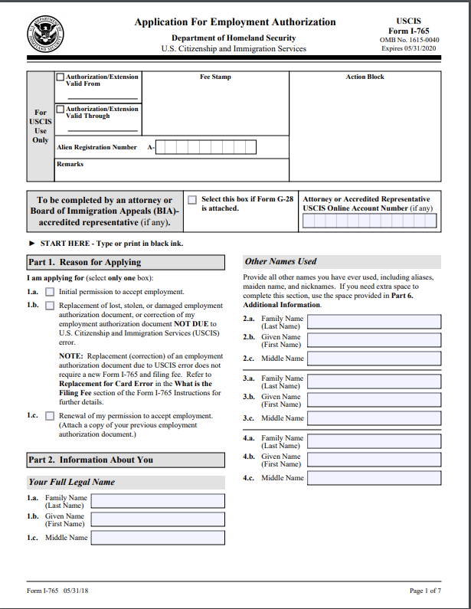
I-765
Tips for completing the I-765
READ THE I-765 INSTRUCTIONS
www.uscis.gov/i-765
Go through all instructions, especially if you have been previously authorized for CPT or OPT, as there are additional reporting responsibilities outlined in the instructions.
REASON FOR APPLYING Select the “Initial permission to accept employment” as
the reason for applying.
U.S. MAILING ADDRESS
IMPORTANT: If there is any chance you will move before
you receive your EAD card, please use ISSA’s address as
your U.S. Mailing Address. We will contact you when you receive mail.
SOCIAL SECURITY NUMBER
If you do not have an SSN, you can apply for one with this
form.

Slide 16
I-765
FORM I-94 ARRIVAL-DEPARTURE RECORD NUMBER
It can be found on your I-94 online record or card.
ELIGIBILITY CATEGORY
Post-completion OPT: “(c) (3) (B)”
SIGN AND DATE IN BLACK INK
SUBMISSION
Submit all pages of the I-765, even if you have not written
on that page. USCIS will deny your application if pages
are missing.
DO NOT LEAVE FIELDS BLANK—write N/A or NONE
For additional detailed information on how to fill out the I-765, please go to issa.nd.edu.

Slide 17
OPT Frequently Asked Questions
Can employment be unpaid, an internship or volunteer work?
Yes, employment during standard OPT can be unpaid.
Will I be able to obtain a new visa while on OPT?
Yes, you are still in F-1 status while on OPT and STEM.
Is it possible to expedite my OPT application?
No, though you can include your offer letter and hope. Expediting is at the discretion of USCIS.
Can I hold more than one job at a time?
Yes, but all employment must be related to your degree and reported to ISSA.
How do I report my employment or address change?
Go to ISSAlink.nd.edu to submit employment or address changes.
Can I take classes while on post-completion OPT?
Yes, but use caution. It is risky to take classes that will count towards a degree program.

Slide 18
OPT Application Process Review
Complete the online OPT application on ISSAlink and have your Advisor submit the online OPT Advisor Recommendation form.
Bring your completed application packet to ISSA (105 Main Building) Monday-Friday, 1-4pm to review with an advisor and receive the OPT I-20 with mailing instructions.
MAIL THE OPT APPLICATION so that it is received by USCIS:
No earlier than 90 days prior to the program end date on your I-20.
No later than 60 days after the program end date on your I-20.
No later than 30 days after OPT is recommended on your I-20.
Once OPT is approved, report any and all employment and address changes to the ISSA within 10 days using ISSAlink.nd.edu.

Slide 19
Important Dates for Post-Completion OPT
90 days before
Program End Date
60 days after
Program End Date
Program End Date
February 18, 2019
May 19, 2019
July 18, 2019
If USCIS receives the OPT application packet before or after this time range, it will be DENIED!
Other Important Dates
Receipt Notice Arrival: within three weeks after submitting application
EAD Card Start Date: set within 60 day grace period
Unemployment: allowed 90 days of unemployment from start date on EAD card
Notes:
Based on the Program End Date, students determine the OPT start date that will be on the EAD card.
The first possible EAD card start date is May 20, 2019; the last possible start date is July 18, 2019.

