Slide 1
Mendoza “How To” Guide: Finding Interview Questions in MAGIC

Slide 2
How To
Guide
MAGIC Interview Database
MAGIC is an incredibly powerful tool. However, its utility is limited if students don’t populate it with data (offer data, interview questions, etc.). Pay it forward by entering your information.
This guide is focused on helping you find questions asked during previous interviews.

Slide 3
How To
Guide
MAGIC Interview Database
NOTE: If you have not yet logged on to MAGIC, please click on “Sign Up”, enter your ND email address (use your short, netID version), select a password, and complete your profile.
Contact Shawn Pulscher with any questions.

Slide 4
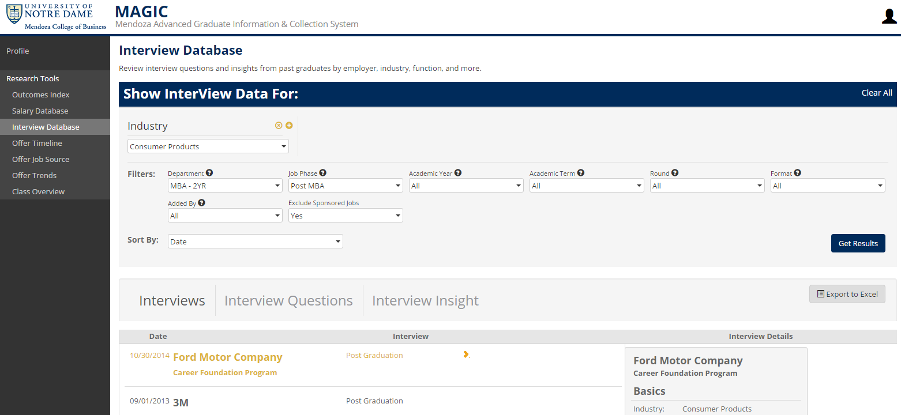
How To
Guide
MAGIC Interview Database
1. Login to MAGIC and select “Interview Database” from left menu bar

Slide 5
How To
Guide
MAGIC Interview Database
2. To search for questions by employer (vs. default filter of “Industry”), click on the little yellow “x” next to “Industry”

Slide 6
How To
Guide
MAGIC Interview Database
3. Select “Employer” from list of “Recommended Attributes”

Slide 7
How To
Guide
MAGIC Interview Database
4. Use box to search for employer; employers in system will auto-populate as you search
5. Click on employer of choice once you find it

Slide 8
How To
Guide
MAGIC Interview Database
4. Use drop-down menus to select additional filters (we recommend NOT selecting these unless the number of returns is very long)
5. Click on “Get Results”

Slide 9
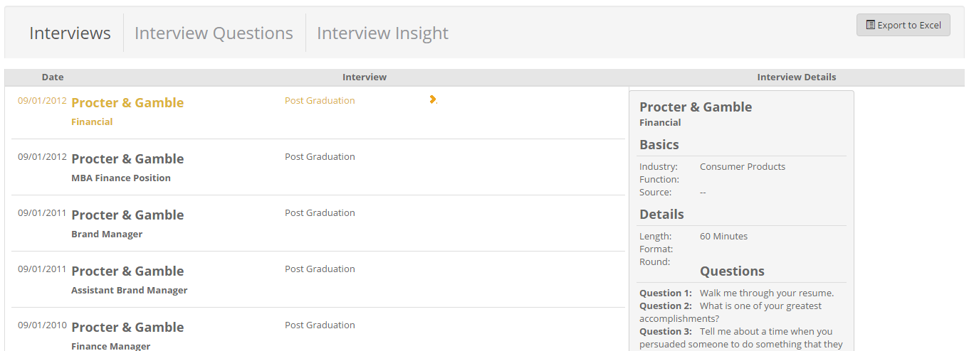
How To
Guide
MAGIC Interview Database
6. Scroll down to view interview details and individual questions

